Slide 1
Dear Parents,
We hope you are all safe and well.
As of this week, we will be reducing the amount of work provided for Nursery. This is because of the volume already present. The work will now consist of a set of weekly activities linked to a theme where possible. You will receive literacy, maths, phonics and practical activities for the week along with an RE and collective worship session on Google Classroom.
We have provided a vast array of practical work and stories over the last few months which are still accessible through Google Classroom. If you feel you require more work over the week you are more than welcome to look through work from previous weeks that you haven’t accessed yet or repeat activities your child has enjoyed as repetition is very important in cementing the children’s learning. If you feel this is still not enough, please email our class email and let us know how we can help further.
In addition to this, we had the pleasure of speaking to a few parents and children over the phone on Friday. The children are missing their friends and teachers and we are missing you all too! We thought it would be lovely if you could record a small clip of your child saying hello to the rest of the nursery class. We will then edit these together in a video so the children can see all of their friends.
Please send the video clips to our class email nursery@sacredheart-jun.manchester.sch.uk or upload them to the relevant section of Google Classroom. Please send these videos in by the end of the week.
Thank you

Slide 2
Sacred Heart Nursery Pirate Week
This week in Nursery it is pirate week! Attached to this PowerPoint are a set of pirate tasks to complete over the course of the week.
There will be a space on Google Classroom to upload any work from each topic. Please also remember to check Google Classroom for your weekly RE and collective worship session each week.
If you would like to send us any other pictures or videos throughout the week, please continue to do this through Class Dojo.

Slide 3
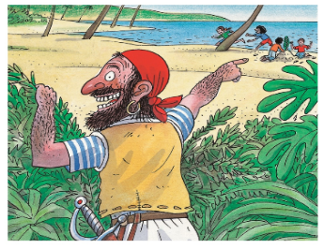

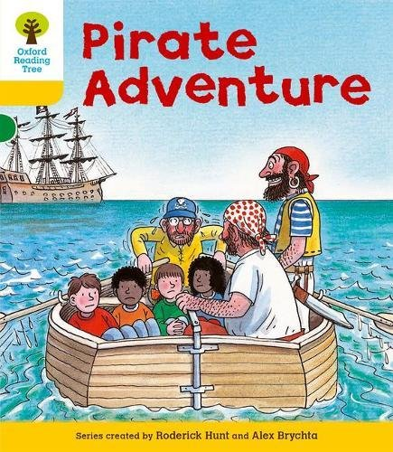
Literacy Activities
Introduce the story Pirate Adventure. Click on the picture to view this as an Oxford Owl E-book which reads the story out loud. Make sure you are logged in to Oxford Owl first. You may need to sign up if you haven’t already. Alternatively, view the story through the uploaded PowerPoint on Google Classroom.
Read the story to your children, stop before the end of story on pg. 17. Ask your child what they think will happen at the end. Can they suggest an ending? We would love to hear what ideas they come up with!
Finish reading the story.
Look at the pictures from the story on the next page.
Ask your child to point to a picture that was at the beginning of the story, a picture that was at the end of the story and a picture that was in the middle.
Ask your child to verbally answer the questions on the following slides.

Slide 4
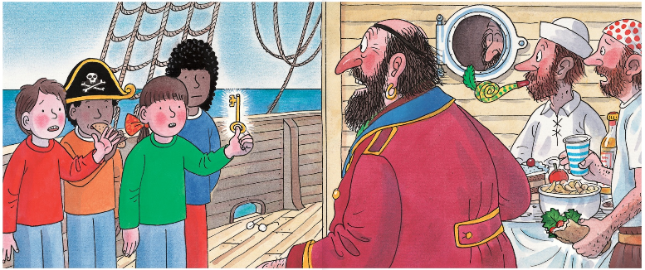

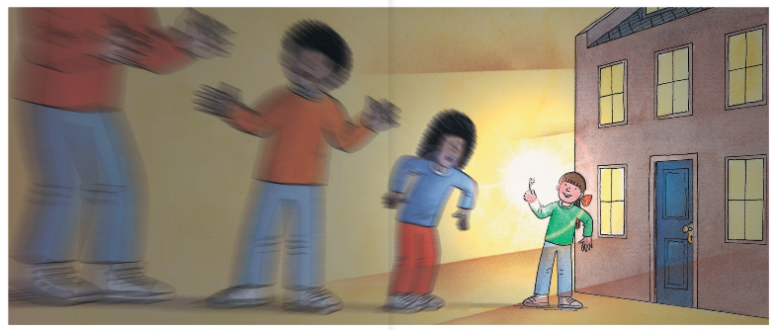
Can you point to a picture that was at the beginning of the story?
Can you point to a picture that was at the end of the story?
Can you point to a picture that was in the middle of the story?

Slide 5
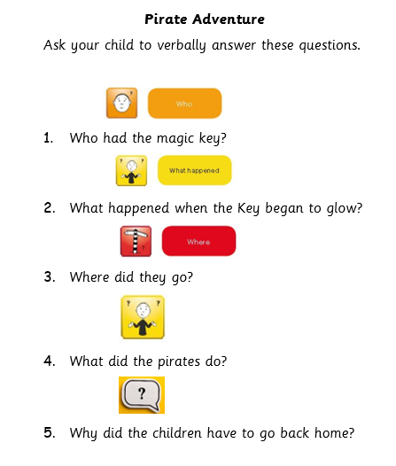

Slide 6
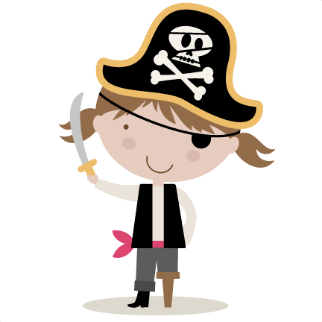
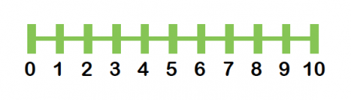
Maths Activities
Watch and join in with the pirate counting song by clicking on the pirate picture.
Talk to your child about how the song went up by 1 more each time. It started with one, then one more and they were 2 and one more and they were 3.
Tell your child that they are going to be looking at 1 more than a number, the number that comes after. Look at the number line below. Point to a number. Ask what is the number that comes after? Were they accurate? Show them the next number. Say e.g. 1 more than 3 is 4. Repeat this a few times
Look at the pirate counting sheet on the next page. Ask your child to count the objects on the screen. Ask them how many they would have if they had 1 more? Tell them if they are not sure. You can show them by counting a small group of objects at home and adding 1 more, then predicting how many and counting them again.
Can your child climb the stairs by adding on one more? Starting at one they can stand on the first step and say 1 then as they move to the second step say, ‘1 more than 1 is… 2’, ‘1 more than 2 is 3’ etc.. until they reach the top. How many steps were there?

Slide 7
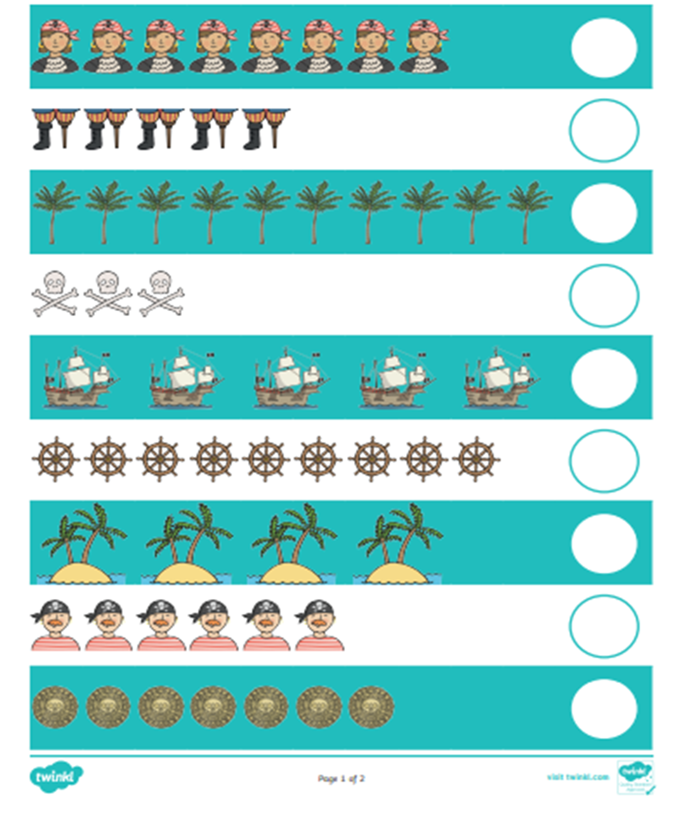
Pirate Counting
Count how many pirate objects there are.
How many will there be if you add one more?

Slide 8
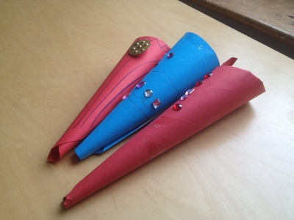
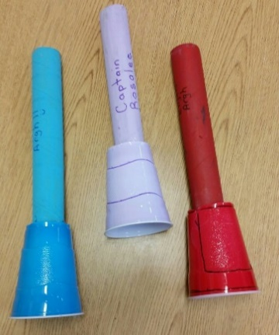
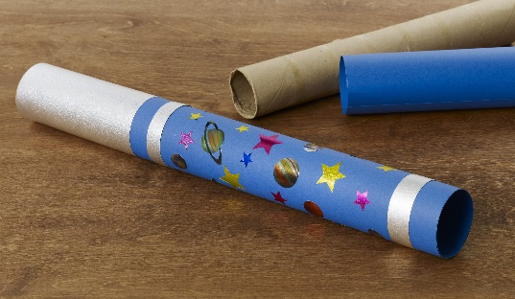

Phonics Activities
Create a pirate telescope which we will use for the rest of the phonic activities.
You could use card, toilet roll tubes, plastic cups or anything else you can find around your home.
We would love to see your creations.
Hide your phonics flashcards around your home or garden for your child. Using their telescope, can your child find and identify all of the sounds. You could even hide some treasure for them to find too!
(If you haven’t already made your phonics flashcards, now would be a great time to do this. Working with your child, create flashcards for each of the sounds they have learnt so far. Encourage your child to form the letters correctly using your letter formation sheet and practice saying the sounds.)
Ask your child what sound ‘pirate’ begins with? That’s right.. p-p-pirate! Tell your child that Pirate Pete is looking for items beginning with the ‘p’ sound. Walk around your home with your child encouraging them to look for items that begin with ‘p’ through their telescope.
Once you have found ‘p’ items, mix them up with other objects that do not begin with ‘p’. Can your child sort the objects into treasure that begins with ‘p’ for Pirate Pete and trash, that does not begin with ‘p’.

Slide 9

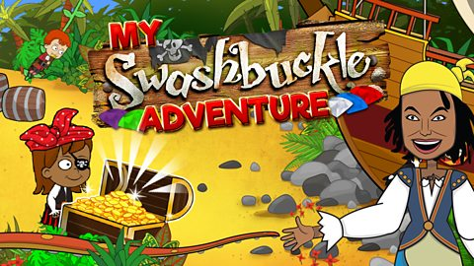
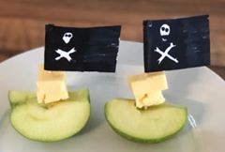
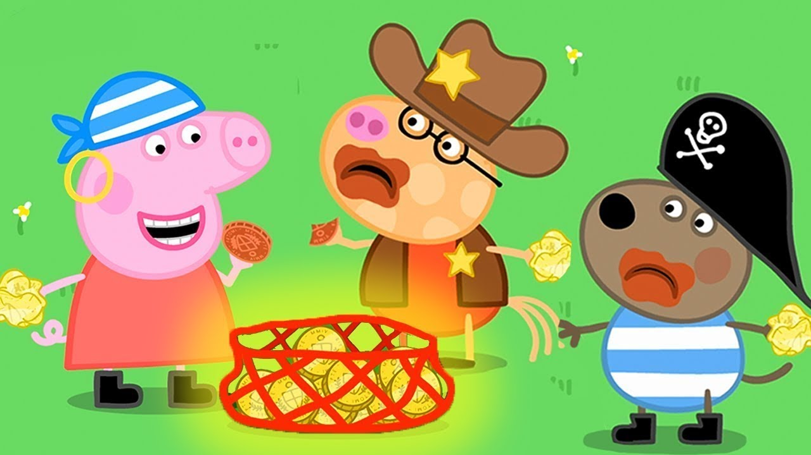
Extra Activities
Complete some pirate yoga by clicking on this picture.
Create a tasty pirate snack! Follow the instructions on the next page to make cheese and apple pirate ships.
Watch Peppa Pig – Pirate Treasure by clicking on this picture.
Play the CBeebies Swashbuckle pirate game by clicking on this picture.

Slide 10
